Slide 1
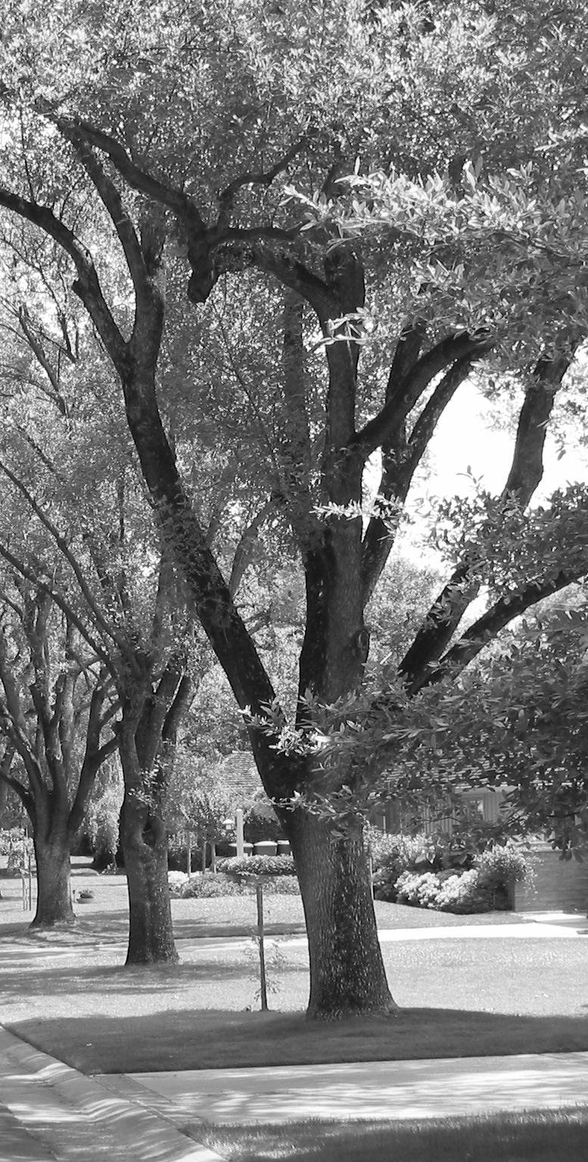
Hierarchical Data Structures
CE-1103 Algorithms and Data Structures

Slide 2
Disclaimer / Descargo de Responsabilidad
Esta presentación corresponde a una guía usada por el profesor durante las clases. La misma ha sido modificada para ser utilizado en el modelo de cursos asistidos por tecnología. No es una versión final, por lo que la misma podría requerir todavía hacer algunos ajustes. Para aspectos de evaluación esta presentación es solo una guía, por lo que el estudiante debe profundizar con el material de lectura asignado y lo discutido en clases para aspectos de evaluación.
This presentation corresponds to a guide material used by the professor during classes. It has been modified to be used in the model of technology-assisted courses. It is not a final version, so it may still require some adjustments. For evaluation aspects, this presentation is only a guide, so the student should delve with the assigned reading material and what has been discussed in class.

Slide 3

What is a tree?
A tree is one of the fundamental data storage structure used in programming
It combines the advantages of an ordered array and a linked list
Fast searches
Fast insertion and deletion

Slide 4

Going back...
About arrays
Why searching is fast?
Why insertion/deleting is expensive and slow?
About linked-list
Why searching is slow?
Why insertion/deletion is fast?

Slide 5
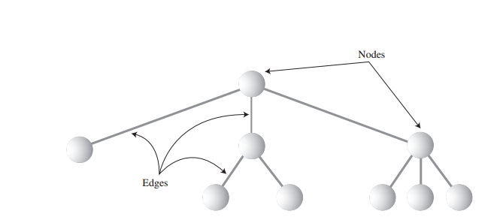
What is a tree!?
A tree consists of nodes connected by edges. Nodes are represented as circles and the edges as lines connecting the circles

Slide 6
What is a tree!?
Just like in linked-lists, nodes are composed of data and references (edges) to other nodes
Given that trees are mathematical entities, there is many theoretical knowledge about trees
A tree is specialization of a graph

Slide 7
What is a tree!?
Trees are small on top and large on the bottom. Like inverted real life trees
There are many types of trees:
Binary trees
Heap trees
AVL
Splay
B, B+, B*
Expression trees
N-ary trees

Slide 8
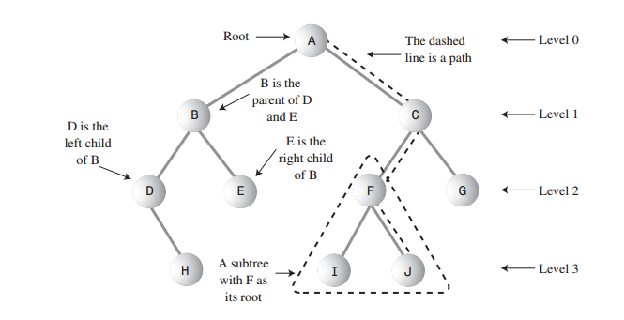
Tree
Terminology

Slide 9

Trees
Applications
Implement file systems
Organizate data that needs to be searched
In databases, data is stored as B trees or any of its variations

Slide 10
Trees
Applications
Compression algorithms
Compilers use trees to represent syntactic expressions

Slide 11
Tree terminology
“Walking” from node to node results in a sequence of nodes, this is called path
The node at the top of the tree is called the root. There is only one root
Any node (except the root) has exactly one edge running upward to another node. The node above is called the parent of the node

Slide 12
Tree terminology
Any node may have one or more lines running downward to other nodes. These nodes below are called children
A node that has no children is called a leaf
Any node can be considered to be the root of a subtree. A subtree contains all descendents of a node

Slide 13
Tree terminology
Nodes with the same parent are called siblings
The length of a path is the number of edges on the path. There is a path of length zero from every node to itself
The depth of a node is the length of the unique path from the root to the node.

Slide 14
Tree terminology
Root is at a depth of zero
The height of a tree is the length of the longest path from the node to a leaf

Slide 15
Tree terminology
A node is visited when program control arrives at the node, usually for the purpose of carrying out some operation on the node. If nothing is done on the node, then is not visiting.
Traverse a tree is visiting all the nodes in some specific order

Slide 16
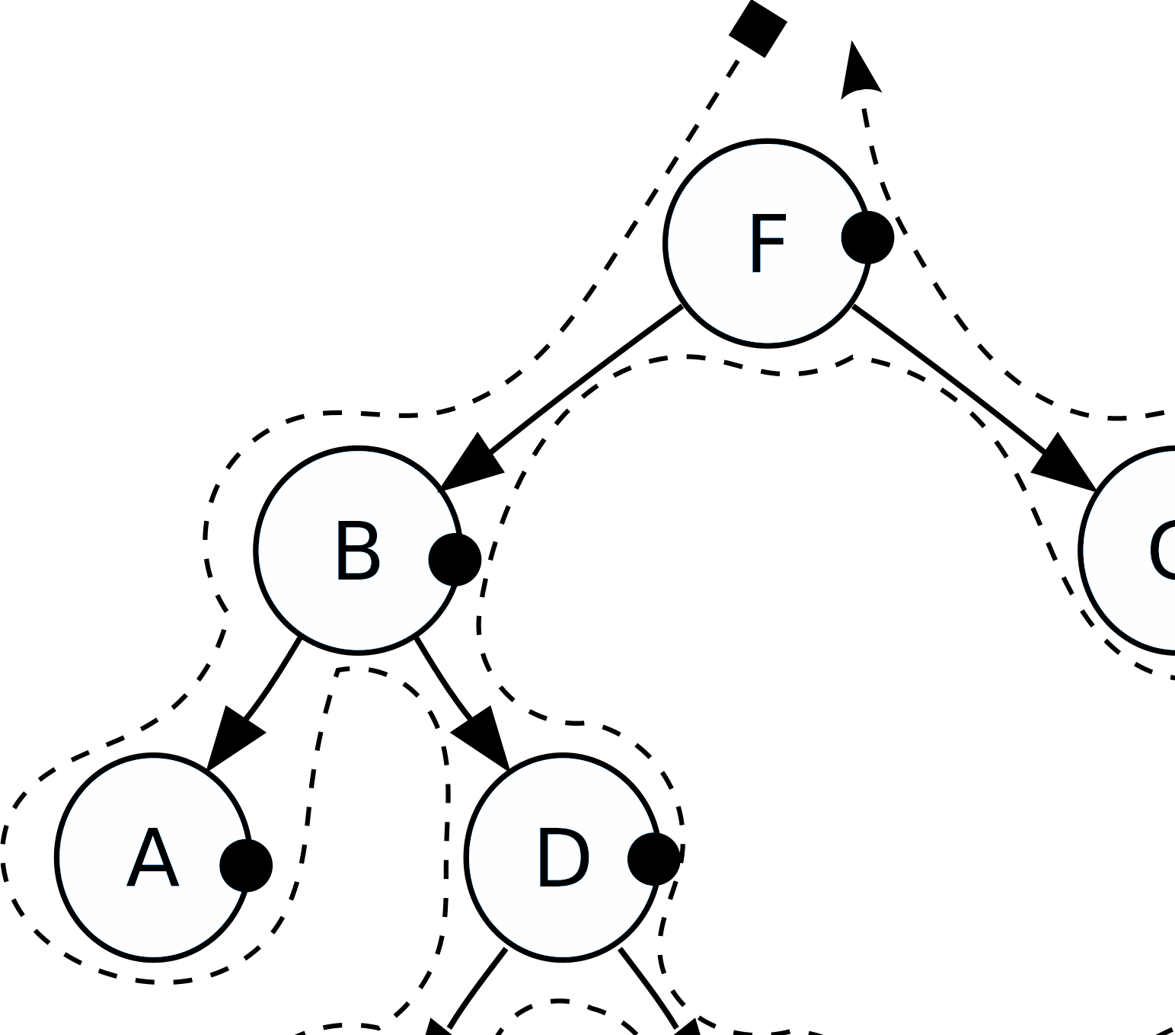
Binary trees

Slide 17
What is a binary tree?
Is a tree where each node can have at most two children
The two children are called the left child and the right child
If the left child node key is smaller than the key of the parent and the right child key is greater, the tree is called binary search tree (BST)

Slide 18
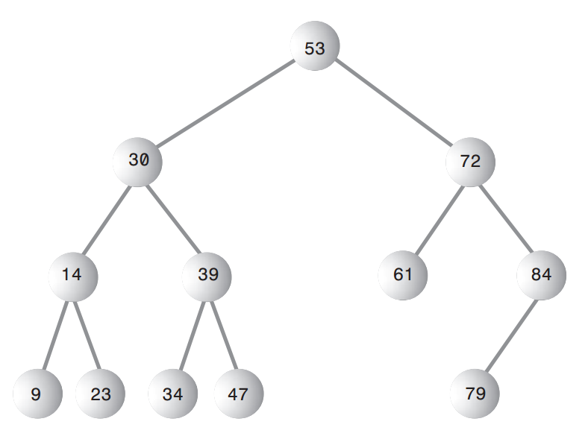
What is a binary tree?

Slide 19
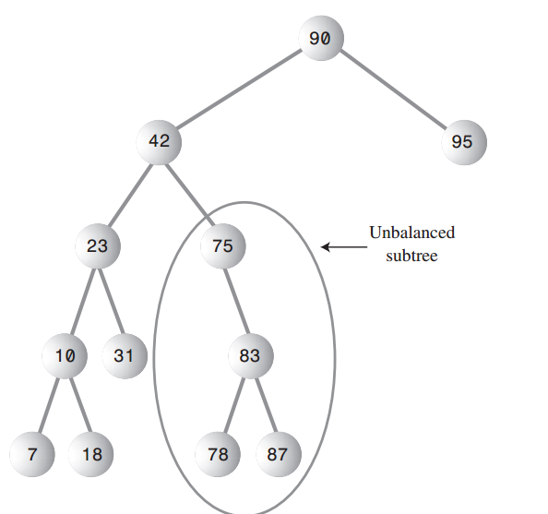
What is a binary tree?
Depending on the insertion order, a tree can become unbalanced.

Slide 20
Binary search trees
Implementation
Trees can be implemented using arrays or using dynamic memory like a linked-list
The most common way of implementation is using dynamic memory. We will focus on this approach

Slide 21
Binary search trees
Implementation
01 02 03 04 05 06 07 08 09 10 11 12 13 14 15 16 17 | public class Node<T extends Comparable<T>> { T element Node<T> left; Node<T> right; public Node(T element) { this(element, null, null); } public Node(T element, Node<T> left, Node<T> right) { this.element = element; this.left = left; this.right = right; } }

Slide 22
Binary search trees
Implementation
01 02 03 04 05 06 07 08 09 10 11 12 13 14 15 16 17 | public class BinaryTree<T extends Comparable<T>> { private Node<T> root; public BinaryTree() { this.root = null; } public boolean isEmpty() { return this.root == null; } }

Slide 23
Binary search trees
Contains operation
Returns true if there is a node in the tree that has item element or false if there is no such node
If the tree is empty it just returns false, otherwise make a recursive call on a subtree, either left or right

Slide 24
Binary search trees
Contains operation
01 02 03 04 05 06 07 08 09 10 11 12 13 14 15 16 17 | public class BinaryTree<T extends Comparable<? super T>> { private Node<T> root; public BinaryTree() { this.root = null; } public boolean isEmpty() { return this.root == null; } public boolean contains(T element) { return this.contains(element, this.root); } }

Slide 25
Binary search trees
Contains operation
01 02 03 04 05 06 07 08 09 10 11 12 13 14 15 16 17 | public class BinaryTree<T extends Comparable<? super T>> { private boolean contains(T element, Node<T> node) { if (node == null) { return false; } else { int compareResult = element.compareTo(node.element); if (compareResult < 0) return contains(element, node.left); else if (compareResult > 0) return contains(element, node.right); else return true; } } }

Slide 26
Binary search trees
min/max operation
01 02 03 04 05 06 07 08 09 10 11 12 13 14 15 16 17 | public class BinaryTree<T extends Comparable<? super T>> { public Node<T> findMin() { if (this.isEmpty) { return null; } else { return this.findMin(this.root).element; } } public Node<T> findMax() { if (this.isEmpty) { return null; } else { return this.findMax(this.root).element; } } }

Slide 27
Binary search trees
min/max operation
01 02 03 04 05 06 07 08 09 10 11 12 13 14 15 16 17 | public class BinaryTree<T extends Comparable<? super T>> { private Node<T> findMin(Node<T> node) { if (node == null) return null; else if (node.left == null) return node; else return findMin(node.left); } private Node<T> findMax(Node<T> node) { if (node!= null) while (node.right != null) { node = node.right; } return node; } }

Slide 28
Binary search trees
Insert operation
To insert element in the tree T, proceed down the tree as in the contains operation
If element is found, do nothing or update something in the node. Otherwise insert element at the last spot on the path traversed

Slide 29
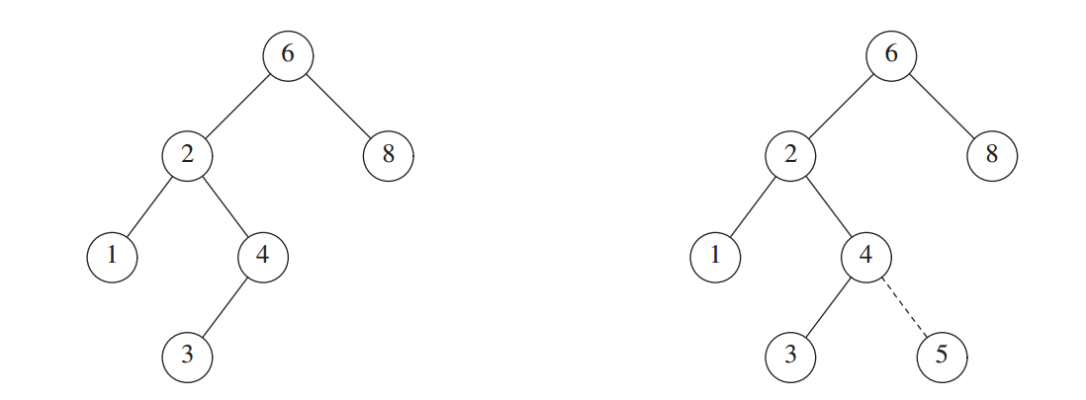
Binary search trees
Insert operation

Slide 30
Binary search trees
Insert operation
01 02 03 04 05 06 07 08 09 10 11 12 13 14 15 16 17 18 | public class BinaryTree<T extends Comparable<? super T>> { public void insert(T element) { this.root = this.insert(element, this.root); } private Node<T> insert(T element, Node<T> current) { if (current == null) return new Node<T>(element, null, null); int compareResult = element.compareTo(node.element); if (compareResult < 0) current.left = this.insert(element, node.left); else if (compareResult > 0) current.right = this.insert(element, node.right); return current; } }

Slide 31
Binary search trees
Delete operation
Delete is the hardest operation
Once we have found the node we want to delete, we have to consider several possibilities
When node is a leaf
When node has one child
When node has two child

Slide 32
Binary search trees
Delete operation
When the node is a leaf, is as simple as deleting that node.

Slide 33
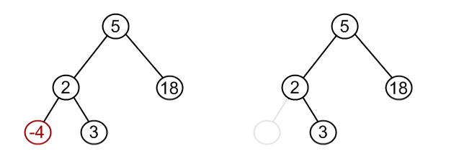
Binary search trees
Delete operation
Remove -4

Slide 34
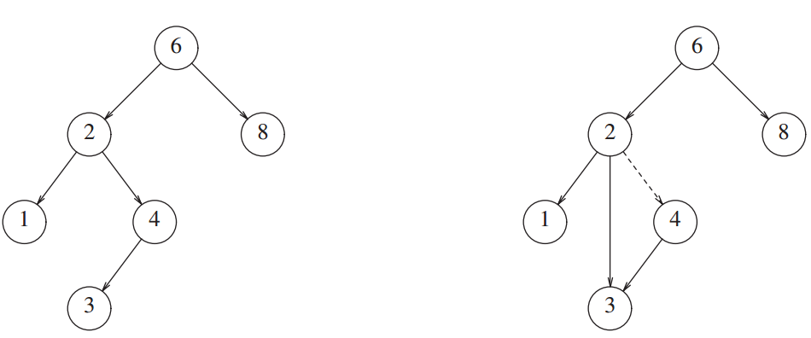
Binary search trees
Delete operation
When the node has one child, the parent has to adjust its link to bypass the node

Slide 35
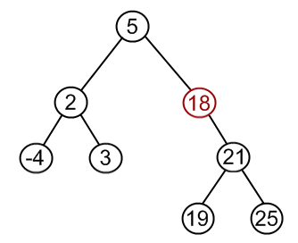
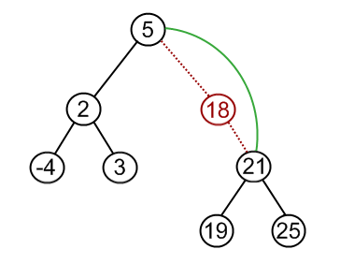
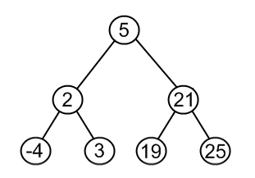
Binary search trees
Delete operation
Remove 18

Slide 36
Binary search trees
Delete operation
When the node has two children, the strategy is to replace the data of the current node with the smallest data of the right subtree and recursively delete that node (the one that replaced)
Or replace the data of the current node with the biggest data of the left subtree and recursively delete that node (the one that replaced)

Slide 37
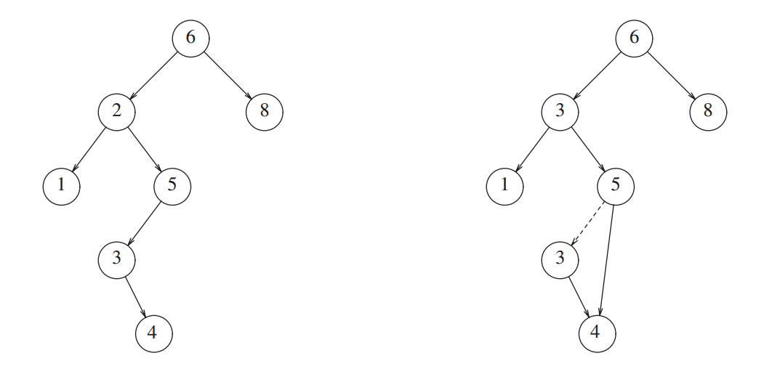
Binary search trees
Delete operation

Slide 38
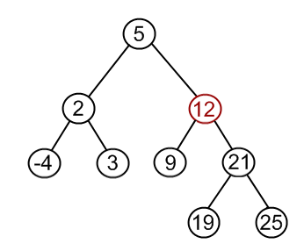
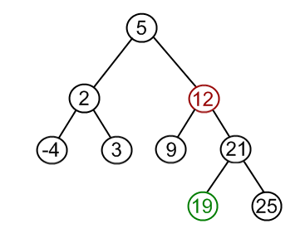
Binary search trees
Delete operation
Remove 12

Slide 39
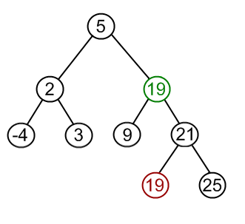
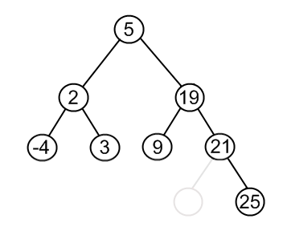
Binary search trees
Delete operation
Remove 12

Slide 40
Binary search trees
Delete operation
01 02 03 04 05 06 07 08 09 10 11 12 13 14 15 16 17 18 | public class BinaryTree<T extends Comparable<? super T>> { public void remove(T element) { this.root = this.remove(element, this.root); } }

Slide 41
Binary search trees
Delete operation
01 02 03 04 05 06 07 08 09 10 11 12 13 14 15 16 17 18 19 20 | public class BinaryTree<T extends Comparable<? super T>> { public void remove(T element, Node<T> node) { if (node == null) return node; int compareResult = element.compareTo(node.element); if (compareResult < 0) node.left= remove(element, node.left); else if (compareResult > 0) node.right = remove(element, node.right); else if (node.left != null && node.right != null){ node.element = findMin(node.right).element; node.right = remove(node.element, node.right) } else { node = node.left != null ? node.left : node.right; } return node; } }

Slide 42
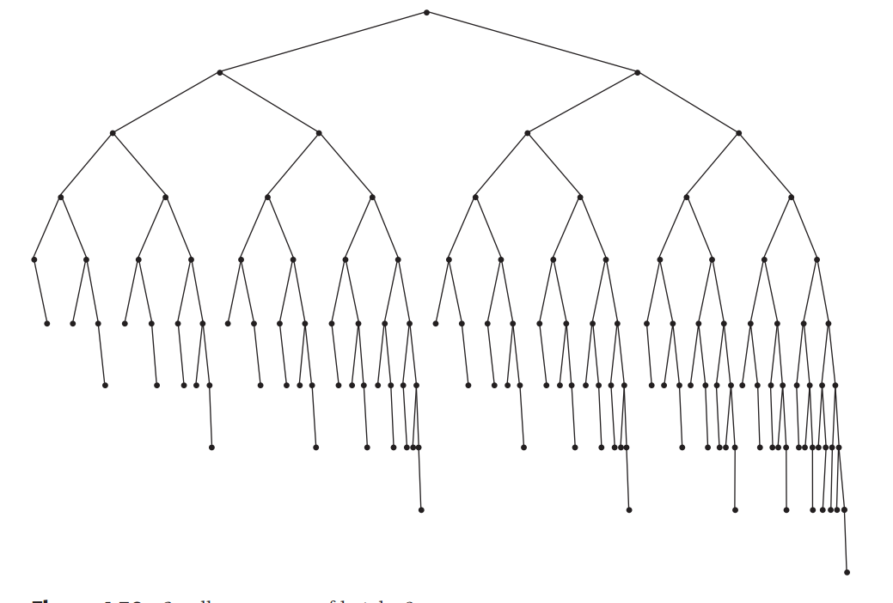
AVL

Slide 43
What is an AVL tree?
AVL means Adelson-Velskii and Landis
Is a binary search tree with a balance condition. This condition is easy to maintain ensuring that the depth of the tree is O(logN)
Height of the left and right side can only differ by one

Slide 44
What is an AVL tree?
In the AVL context, the height of a tree is the maximum level of a tree plus one
A null tree has a height of zero

Slide 45
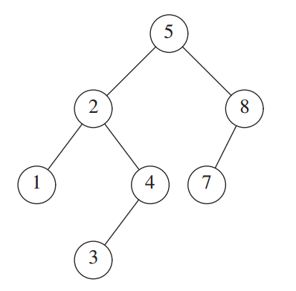
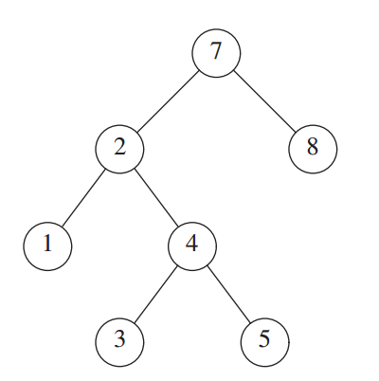
What is an AVL tree?
Only this is AVL

Slide 46
What is an AVL tree?

Slide 47
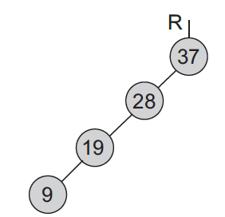
A tree can get unbalanced
In an specific sequence a binary search tree can become like this:
In this scenario, searches will be completely sequential, losing the purpose of the tree.
A tree like this is called unbalanced

Slide 48
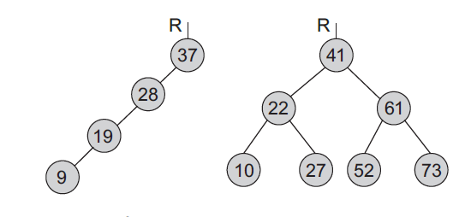
A tree can get unbalanced

Slide 49
A tree can get unbalanced
The purpose of balancing is to make searches more efficient

Slide 50
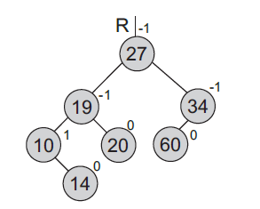
AVL tree
Each node of an AVL tree has a balance factor
Balance factor is defined as the height of the right subtree minus the height of the left subtree.
Balance factor can be 1,0,-1

Slide 51
AVL tree
Let’s calculate balance factor

Slide 52
AVL tree
Let’s calculate balance factor

Slide 53
AVL tree
Let’s calculate balance factor

Slide 54
AVL tree
Let’s calculate balance factor

Slide 55
AVL tree
Let’s calculate balance factor

Slide 56
AVL Tree
Insert operation
Inserting a new node can result in a violation of the AVL condition
If a violation happens, the AVL condition has to be restored using a modification of the tree known as rotation
After the insertion, only nodes that are on the path from the insertion point to the root have their balance altered

Slide 57
AVL Tree
Insert operation
Follow the same process as the binary search algorithm. New node is added as a leaf with a balance factor of 0
Backtrack the path to recalculate the balance factor
Only the nodes in the search path could have change its value

Slide 58
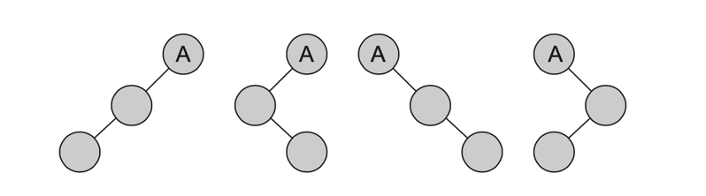
AVL Tree
Insert operation
Let α be the node that needs to be rebalanced, there can be four violation cases:
An insertion in the left subtree of the left child of α
An insertion in the right subtree of the left child of α
An insertion in the left subtree of the right child of α
An insertion in the right subtree of the right child of α

Slide 59
AVL Tree
Insert operation
Left-left and right-right can be resolved with a single rotation
Left-right and right-left can be resolved with a double rotation
Backtrack stops when reaching the root or after performing a rotation. A rotation balances the whole tree

Slide 60
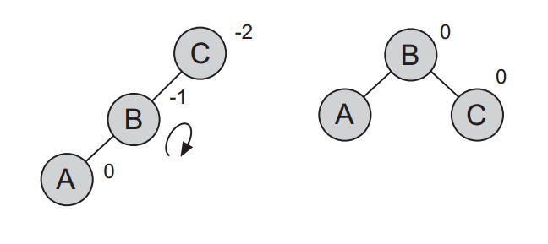
AVL Tree
Single rotation

Slide 61
AVL Tree
Single rotation
n
n1
01 02 03 | n.left = n1.right; n1.right = n; n = n1;

Slide 62
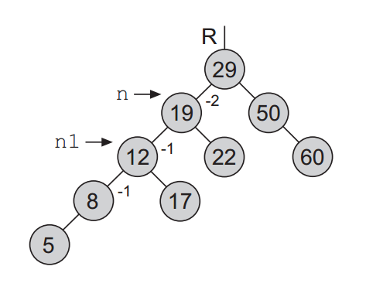
AVL Tree
Single rotation
01 02 03 | n.left = n1.right; n1.right = n; n = n1;

Slide 63
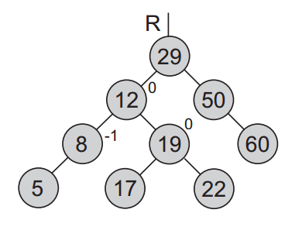
AVL Tree
Single rotation
01 02 03 | n.left = n1.right; n1.right = n; n = n1;

Slide 64
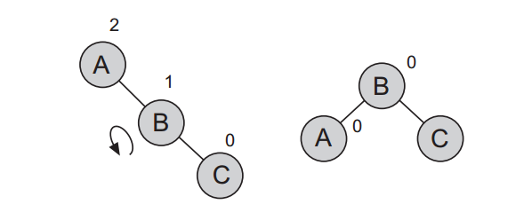
AVL Tree
Single rotation

Slide 65
AVL Tree
Single rotation
n
n1
01 02 03 | n.right = n1.left; n1.left = n; n = n1;

Slide 66
AVL Tree
Double rotation
+2
30
-1
60
40
0

Slide 67
AVL Tree
Double rotation
Single rotation (LL) performed on right subtree
Single rotation (DD) performed on “root”
+2
+2
0
n
30
30
40
-1
+1
n1
60
40
0
0
30
60
40
0
0
n2
60
01 02 03 04 05 | n1.left = n2.right; n2.right = n1; n.right = n2.left; n2.left = n; n = n2;

Slide 68
AVL Tree
Double rotation
-2
30
+1
20
25
0

Slide 69
AVL Tree
Double rotation
Single rotation (DD) performed on right subtree
Single rotation (LL) performed on “root”
-2
-2
0
n
30
30
25
+1
-1
0
20
25
20
0
30
n1
25
0
20
0
n2
01 02 03 04 05 | n1.right = n2.left; n2.left= n1; n.left = n2.right; n2.right = n; n = n2;

Slide 70
AVL Tree
Implementation
01 02 03 04 05 06 07 08 09 10 11 12 13 14 15 16 17 18 | public class AvlNode { int element; AvlNode left; AvlNode right; int height; public AvlNode(int element) { this(element, null, null); } public AvlNode(int element, AvlNode left, AvlNode right) { this.element = element; this.left = left; this.right = right; this.height = 0; } }

Slide 71
AVL Tree
Implementation
01 02 03 04 05 06 07 08 09 10 11 12 13 14 15 16 17 18 | public class AvlTree { private static final ALLOWED_IMBALANCE = 1; private int height(AvlNode t) { return t == null ? -1 : t.height; } private AvlNode insert(int x, AvlNode t) { if (t == null) { return new AvlNode(x); } if (x < t.element) { t.left = insert(x, t.left); } else if (x > t.element) { t.right = insert(x, t.right); } return balance(t); } }

Slide 72
AVL Tree
Implementation
01 02 03 04 05 06 07 08 09 10 11 12 13 14 15 16 17 18 19 20 | private AvlNode balance(AvlNode t) { if (t == null) return t; if (height(t.left) - height(t.right) > ALLOWED_IMBALANCE) { if (height(t.left.left) >= height(t.left.right)) t = rotateWithLeftChild(t); else t = doubleWithLeftChild(t); } else { if (height(t.right) - height(t.left) > ALLOWED_IMBALANCE){ if (height(t.right.right) >= height(t.right.left)) t = rotateWithRightChild(t); else t = doubleWithRightChild(t); } } t.height = Math.max(height(t.left), height(t.right)) + 1; return t; }

Slide 73
AVL Tree
Implementation
01 02 03 04 05 06 07 08 09 10 11 12 13 14 15 16 17 18 | private AvlNode rotateWithLeftChild(AvlNode k2) { AvlNode k1 = k2.left; k2.left = k1.right; k1.right = k2; k2.height = Math.max(height(k2.left), height(k2.right)) + 1; k1.height = Math.max(height(k1.left), k2.height) + 1; return k1; } private AvlNode doubleWithLeftChild(AvlNode k3) { k3.left = rotateWithRightChild(k3.left); return rotateWithLeftChild(k3); }

Slide 74
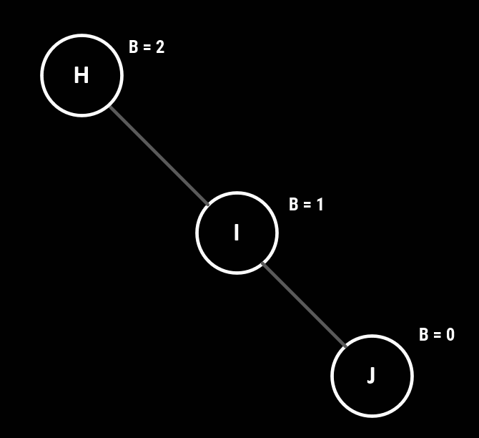
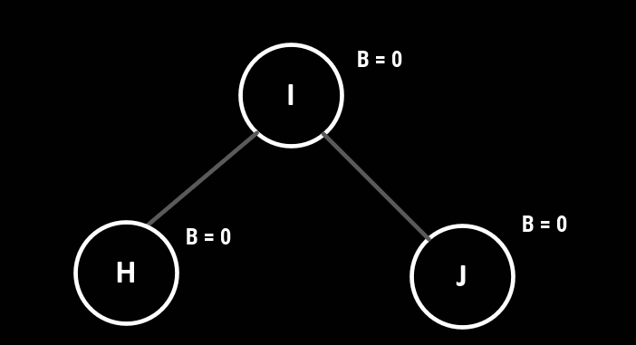
ANOTHER AVL INSERT EXAMPLE
Insert the values: H, I, J, B, A, E
Left Rotation on H

Slide 75
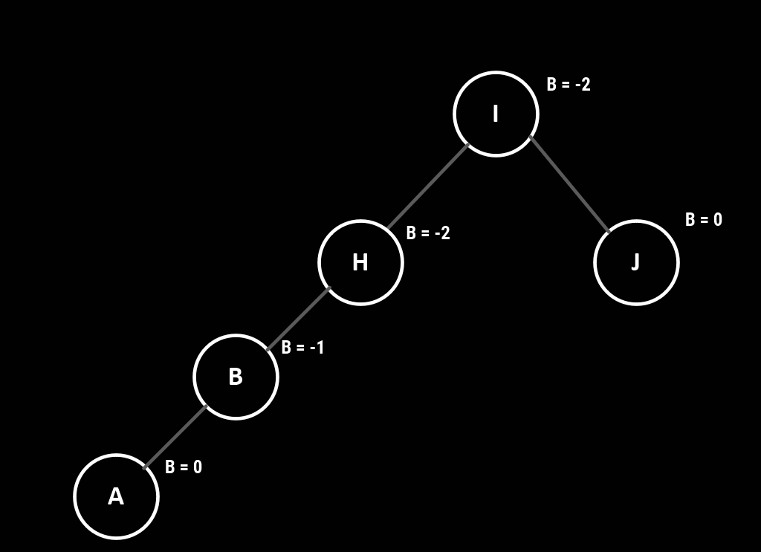
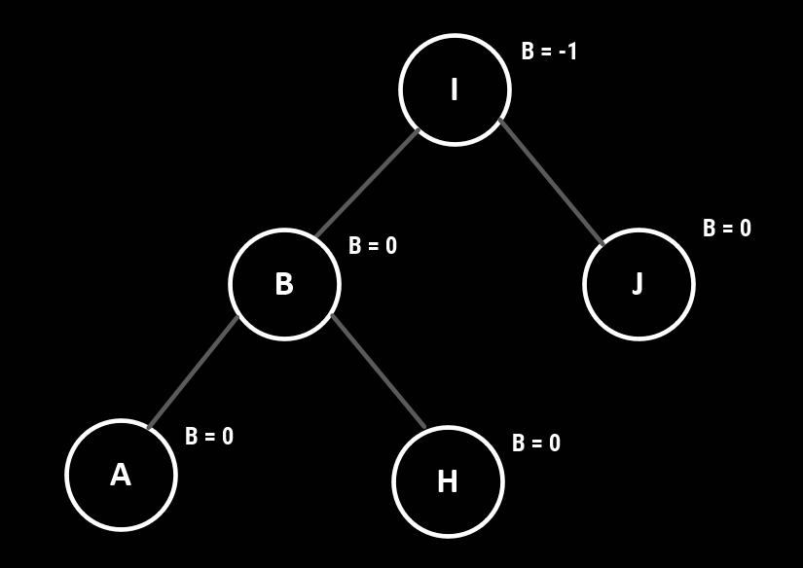
ANOTHER AVL INSERT EXAMPLE
Insert the values: B, A, E
Right Rotation on H

Slide 76
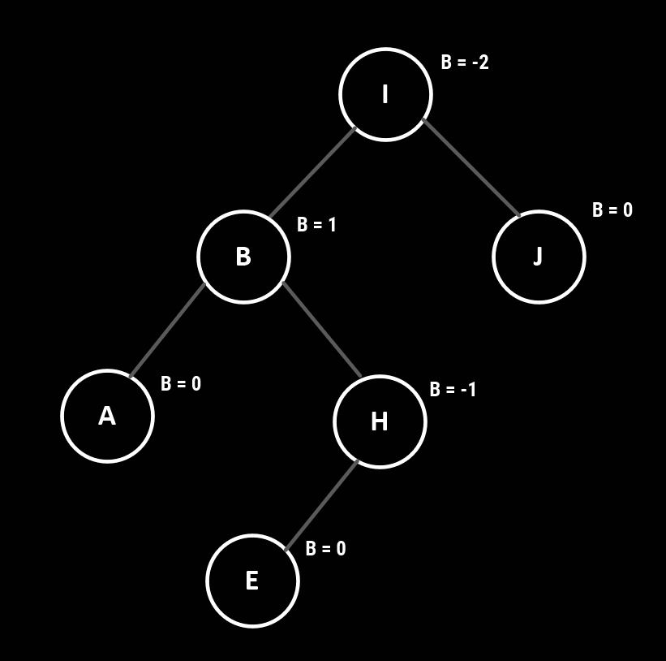
ANOTHER AVL INSERT EXAMPLE
Insert the values: E
-2 indicates left imbalance
1 indicates right imbalance
Left Right case

Slide 77
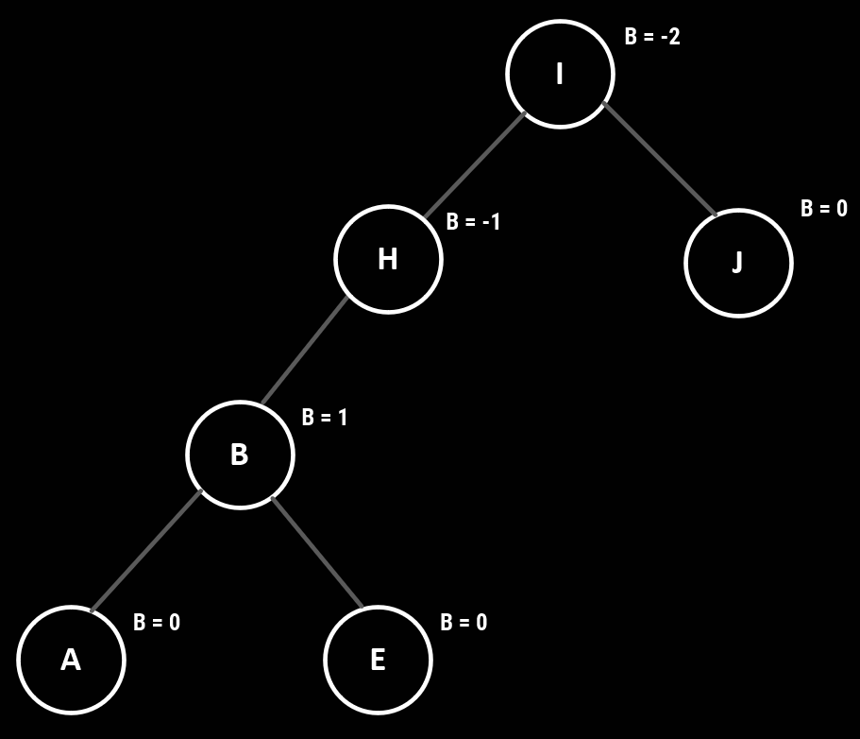
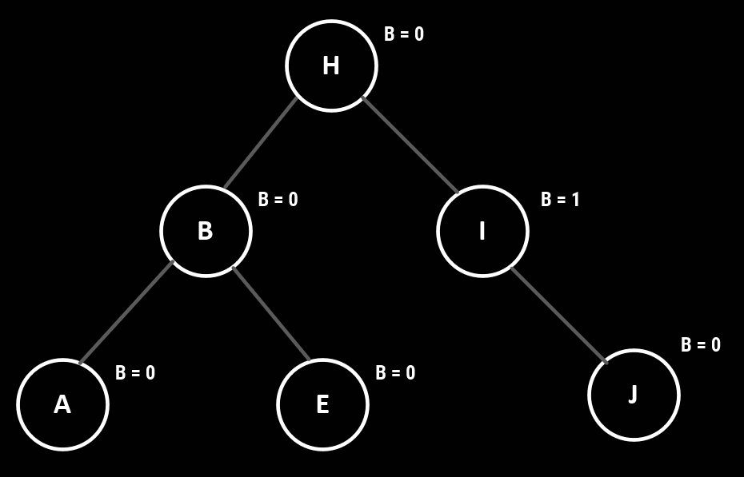
ANOTHER AVL INSERT EXAMPLE
Insert the values: E
Left Rotation on B
Right Rotation on I

Slide 78
Splay tree

Slide 79
What is a splay tree?
Is an efficient implementation of a binary search tree that takes advantage of locality
If a node is accessed, it may probably be accessed frequently
Is an special tree that focus on reducing the access time

Slide 80
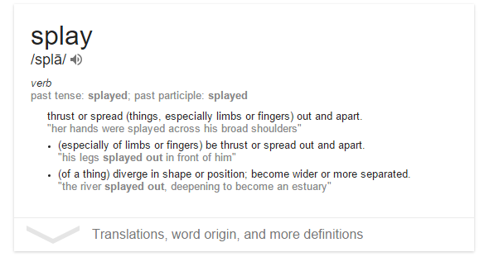
What is a splay tree?
Is an efficient implementation of a binary search tree that takes advantage of locality
If a node is accessed, it may probably be accessed frequently
Is an special tree that focus on reducing the access time

Slide 81
What is a splay tree?
Whenever a node is looked up in the tree, the splay tree reorganizes to move that element to the root of the tree
Elements that are used frequently will likely be near to the top of the tree
There is no height or balance data maintenance

Slide 82
What is a splay tree?
There are three types of rotations:
Zig or Simple rotation
Zig-Zag
Zig-Zig

Slide 83
Simple rotation (Zig)
Let X be a non root node on the access path at which we are rotating
If the parent of X is the root of the tree, we merely rotate X and the root
Is the same as simple rotation in the AVL tree

Slide 84
Simple rotation (Zig)
P
X
X
C
A
P
A
B
B
C

Slide 85
Zig-Zag
This case involves X, a parent P and a grand-parent G.
X is a right child and P is a left child
Is the same as a double rotation of AVL

Slide 86
Zig-Zag
G
X
P
D
P
G
A
X
A
B
C
D
B
C

Slide 87
Zig-Zig
A new kind of rotation
The parent node P and X are either both left children or both right children

Slide 88
Zig-Zig
G
X
P
D
A
P
X
C
B
G
A
B
C
D

Slide 89
Splay tree operations
Insertion: when an item is inserted, a splay is performed
Newly inserted item becomes the root of the tree
Find: the last accessed during the search is splayed
If the search is successful, the node found is splayed
If the search is unsuccessful, the last node compared is splayed

Slide 90
Splay tree operations
FindMin and FindMax: perform a splay after the success
DeleteMin
Perform a FindMin. This brings the minimum to the root and there will be no left child
Use the right child as the new root

Slide 91
Splay tree operations
DeleteMax
Perform a FindMax
Set the root to the post-splay left child

Slide 92
Splay tree operations
Remove:
Access the node to be deleted, bringing it to the root
Delete the root leaving two subtress left (L) and right (R)
Find the largest in L using DeleteMax operation, thus the root of L will have no right child
Make R the right child of L's root

Slide 93
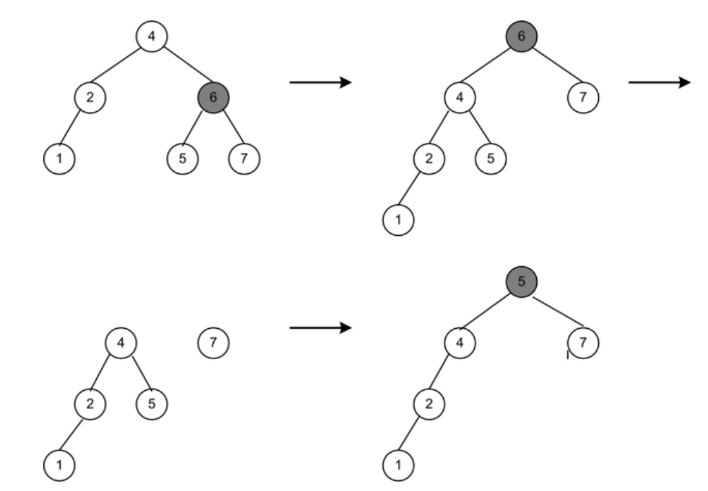
Splay tree operations

Slide 94
Heap

Slide 95
What is a heap?
In a previous topic, we learned about priority queues
Traditionally a priority queue can be implemented with arrays or linked list
There an special kind of tree that can be used to implement a priority queue: heap

Slide 96
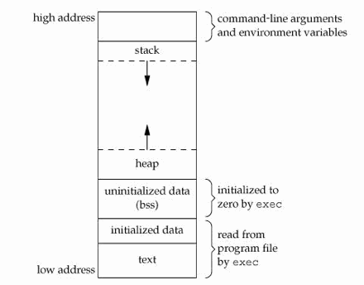
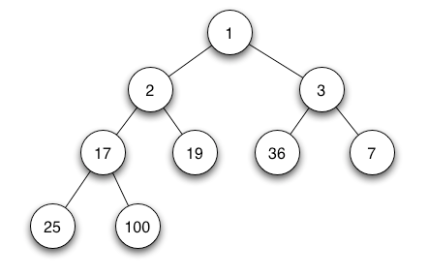
What is a heap?
VS

Slide 97
What is a heap?
Why to choose a heap instead of an array or linked list?
Fast insertion O(logN)
A heap is a binary tree with the following characteristics
It is complete
Implemented as an array
Satisfies the heap condition

Slide 98
What is a heap?
Why to choose a heap instead of an array or linked list?
Fast insertion O(logN)
A heap is a binary tree with the following characteristics
It is complete
Implemented as an array
Satisfies the heap condition
It is completely filled in. Reading from left to right across each row, although the last row does not need to be full

Slide 99
What is a heap?
Why to choose a heap instead of an array or linked list?
Fast insertion O(logN)
A heap is a binary tree with the following characteristics
It is complete
Implemented as an array
Satisfies the heap condition
Stored as an array rather than using references as in a linked list

Slide 100
What is a heap?
Why to choose a heap instead of an array or linked list?
Fast insertion O(logN)
A heap is a binary tree with the following characteristics
It is complete
Implemented as an array
Satisfies the heap condition
Each node in a heap satisfies the heap condition, which means that every node’s key is larger than the key of its children

Slide 101
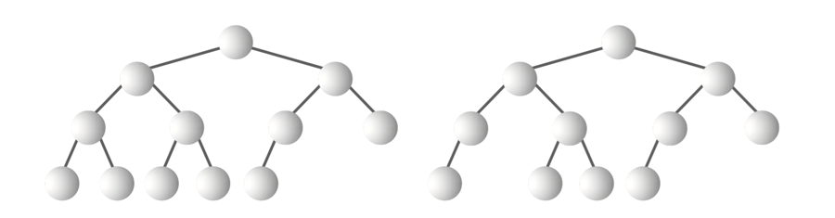
Completeness
VS
Complete
Incomplete

Slide 102
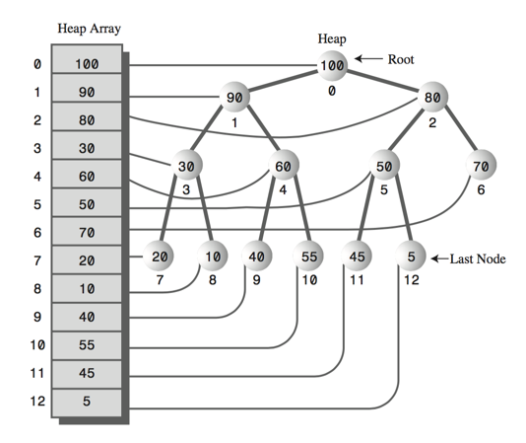
Implementation

Slide 103
Implementation
How do you find the parent of any node or the children of a node in a tree like this?

Slide 104
Implementation
The parent of any node is (k-1)/2 where k is the position of the node

Slide 105
Implementation
Left child of a node is (k*2)+1 and right child is (k*2)+2

Slide 106
Implementation
Maximum value is in the root. Descending-order priority queue

Slide 107
Implementation
There is no way to search for a value like in a binary search tree

Slide 108
Removal operation
Means removing the node with the maximum key.
Maximum key is always the root, so is easy to find
Removing the root leaves the tree incomplete
How to fix it?

Slide 109
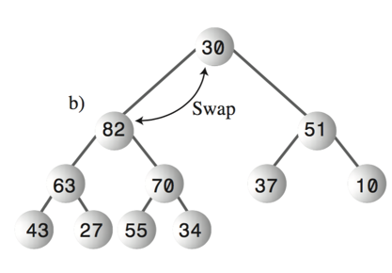
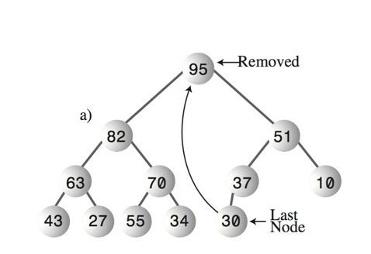
Removal operation
Removal in summary:
Remove the root
Move the last node to the root
Trickle the last node down until it is below a larger node and above a smaller one

Slide 110

Removal operation
Removal in summary:
Remove the root
Move the last node to the root
Trickle the last node down until it is below a larger node and above a smaller one

Slide 111
Removal operation
Removal in summary:
Remove the root
Move the last node to the root
Trickle the last node down until it is below a larger node and above a smaller one

Slide 112
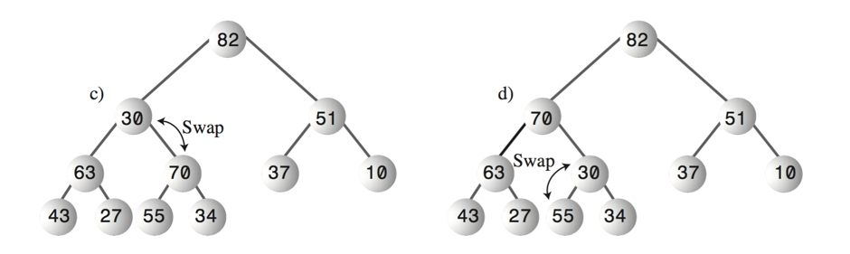
Removal operation
Removal in summary:
Remove the root
Move the last node to the root
Trickle the last node down until it is below a larger node and above a smaller one

Slide 113
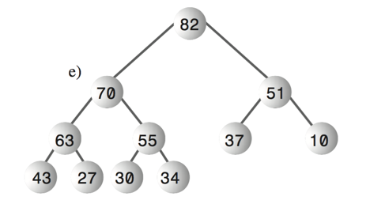
Removal operation
Removal in summary:
Remove the root
Move the last node to the root
Trickle the last node down until it is below a larger node and above a smaller one

Slide 114
Insertion operation
Uses trickle up instead of trickle down
The new node is inserted in the first open position at the end of the array
The problem is that this is likely to violate the heap condition
Trickle up until it is below a node with a larger key and above a node with a smaller key

Slide 115
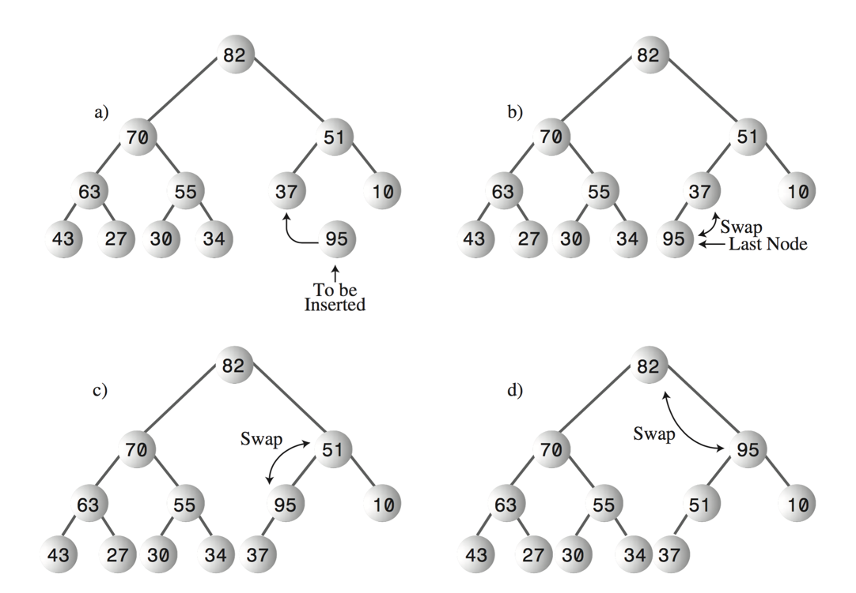
Insertion operation

Slide 116
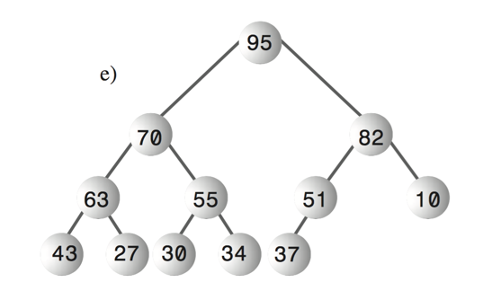
Insertion operation

Slide 117
Insertion operation
Trickle up is easier than trickle down. It does not need to compare the two children

Slide 118
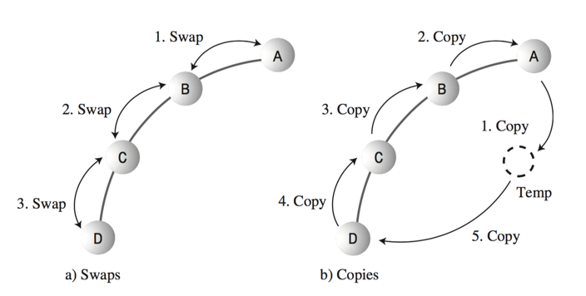
Swapping vs copying

Slide 119
Code implementation
01 02 03 04 05 06 07 08 09 10 11 12 13 14 15 16 | public boolean insert(int key) { if (currentSize == maxSize) { return false; } else { Node newNode = new Node(key); heapArray[currentSize] = newNode; trickleUp(currentSize++); return; } }

Slide 120
Code implementation
01 02 03 04 05 06 07 08 09 10 11 12 13 14 15 16 | public void trickleUp(int index) { int parent = (index-1)/2; Node bottom = heapArray[index]; while (index > 0 && heapArray[parent].getKey() < bottom.getKey()) { heapArray[index] = heapArray[parent]; index = parent; parent = (parent - 1) /2 } heapArray[index] = bottom; }

Slide 121

N-ary Trees

Slide 122
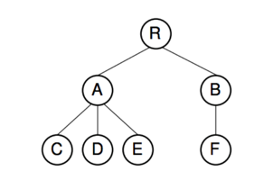
What is an n-ary tree?
As the name implies, in an n-ary tree, each node can have an arbitrary number of children
Are definitely harder to implement than binary trees
Also called non-binary trees, general trees or k-ary trees

Slide 123
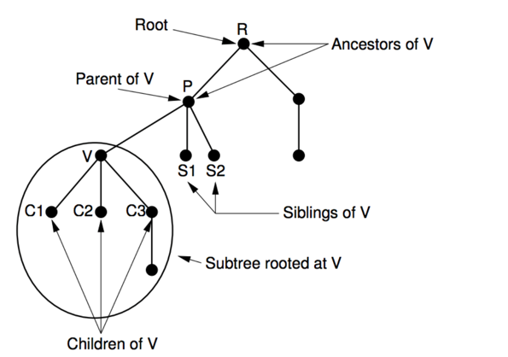
What is an n-ary tree?

Slide 124
ADT of n-ary trees
01 02 03 04 05 06 07 08 09 10 11 12 | class GTNode<E> { E getValue(); boolean isLeaf(); GTNode getParent(); GTNode leftMostChild(); GTNode rightSibling(); void setValue(E); void insertFirst(GTNode); void insertNext(GTNode); void removeFirst(); void removeNext(); }

Slide 125
N-ary trees
How to access the children of a tree?
Not easy because there is no way to know in advance how many are.
Provide access to the left most child and from that node, provide access to the next sibling to the right
Traverse the children as a list of elements
This method is called First child/next sibling method

Slide 126

N-ary trees

Slide 127

N-ary trees

Slide 128
B-trees

Slide 129

Introduction
The trees we have seen so far assume that the entire data structures is in the main memory of the machine
When the data grows, it has to be kept in the disk (at least part of it)

Slide 130
Introduction
Now we are dealing with the latency associated with the disk
The data structures must be optimized to reduce the disk operations or make them as fast as possible
The most popular structure for disk bound searching is the B-Tree

Slide 131
What is a B-Tree?
A B-tree of order m, is a m-ary tree with the following properties:
All the leaves are at the same level
All internal pages, except the root, have a maximum of m branches (non empty) and a minimum of m/2 branches
Key count in each internal page is one minus the branch count. Keys divide the branches in a similar way as a search tree
Root has a maximum of m branches but it can have less than 2

Slide 132
What is a B-Tree?
A B-tree is always perfectly balanced
Nodes are usually called pages
The purpose of a B-Tree is to reduce tree depth, reducing the disk access

Slide 133

What is a B-Tree?

Slide 134
What is a B-Tree?
This is a B-tree of order 5

Slide 135
What is a B-Tree?
Keys are ordered inside the node

Slide 136
What is a B-Tree?
Nodes must be half full to guarantee that the tree does not degenerate into a simple binary tree

Slide 137
What is a B-Tree?
Half full means: at least M/2 to M children
Nodes must be half full to guarantee that the tree does not degenerate into a simple binary tree

Slide 138
What is a B-Tree?
How to choose the order of a B-Tree?

Slide 139
What is a B-Tree?
Choose an order that allows a node to fit in one disk block

Slide 140
What is a B-Tree?
Choose an order that allows a node to fit in one disk block
This will depend of the disk

Slide 141
B-Trees
How to represent a page?
01 02 03 04 05 06 07 08 09 10 11 12 | class Page<E> { List<E> keys; List<Page<E>> branches; int count; int m; }

Slide 142
B-Trees
Insert operation
Keep in mind that B-Trees grow upwards, from the root.
In summary, the insert involves:
Search the key to insert in the tree. There will be a search path determined by the keys in the pages
If the key is not in the in tree, search path will end in a leave.
If the leaf is not full, the insertion is possible
If the leaf is full, split starts to happen.

Slide 143
B-Trees
Insert operation
Splitting a node involves:
Separate the node in halves in the same level.
Mid key goes upward in the search path repeating the insertion process in the in the precedent node.
The ascension of the mid key can propagate up to the root

Slide 144
B-Trees
Insert operation
Let’s insert the following keys to a B-Tree:
6 11 5 4 8 9 12 21 14 10 19 28 3 17 32 15 16 26 27

Slide 145

B-Trees
Insert operation
Let’s insert the following keys to a B-Tree:
6 11 5 4 8 9 12 21 14 10 19 28 3 17 32 15 16 26 27

Slide 146
B-Trees
Insert operation
Let’s insert the following keys to a B-Tree:
6 11 5 4 8 9 12 21 14 10 19 28 3 17 32 15 16 26 27

Slide 147
B-Trees
Insert operation
Let’s insert the following keys to a B-Tree:
6 11 5 4 8 9 12 21 14 10 19 28 3 17 32 15 16 26 27
Node is full, so we need to split

Slide 148

B-Trees
Insert operation
Let’s insert the following keys to a B-Tree:
6 11 5 4 8 9 12 21 14 10 19 28 3 17 32 15 16 26 27

Slide 149

B-Trees
Insert operation
Let’s insert the following keys to a B-Tree:
6 11 5 4 8 9 12 21 14 10 19 28 3 17 32 15 16 26 27

Slide 150

B-Trees
Insert operation
Let’s insert the following keys to a B-Tree:
6 11 5 4 8 9 12 21 14 10 19 28 3 17 32 15 16 26 27

Slide 151

B-Trees
Insert operation
Let’s insert the following keys to a B-Tree:
6 11 5 4 8 9 12 21 14 10 19 28 3 17 32 15 16 26 27

Slide 152

B-Trees
Insert operation
Let’s insert the following keys to a B-Tree:
6 11 5 4 8 9 12 21 14 10 19 28 3 17 32 15 16 26 27

Slide 153

B-Trees
Insert operation
Let’s insert the following keys to a B-Tree:
6 11 5 4 8 9 12 21 14 10 19 28 3 17 32 15 16 26 27
6 11

Slide 154
B-Trees
Delete operation
Deletion is analogous to insertion but a little more complicated
Must ensure that a node don’t get too small during deletion (only root is allowed to have less than m / 2 keys
There are 3 cases for deleting a key

Slide 155

B-Trees
Delete operation: case #1
Key k is in a node x which is a leaf and it have more than (m / 2) -1 keys
Let’s delete F
m = 6

Slide 156

B-Trees
Delete operation: case #1
Key k is in a node x which is a leaf and it have more than ROUND(m / 2) -1 keys
Let’s delete F
m = 6

Slide 157
B-Trees
Delete operation: case #2a
Key k is in a node x which is not a leaf
Let’s delete M
This node precedes M and has more than the minimum key count
m = 6

Slide 158
B-Trees
Delete operation: case #2a
Key k is in a node x which is not a leaf
Let’s delete M
Find the key k’ that precedes M. Delete k’ and replace k by k’
m = 6

Slide 159

B-Trees
Delete operation: case #2a
Key k is in a node x which is not a leaf
Let’s delete M
m = 6

Slide 160
B-Trees
Delete operation: case #2b
Is the mirror case of 2a, but looking for the successor of k in the successor node.
m = 6

Slide 161
B-Trees
Delete operation: case #2c
Key k is in a node x which is not a leaf
Let’s delete G
This node has the minimum keys
m = 6

Slide 162
B-Trees
Delete operation: case #2c
Key k is in a node x which is not a leaf
Let’s delete G
This node has the minimum keys
m = 6

Slide 163

B-Trees
Delete operation: case #2c
Key k is in a node x which is not a leaf
Let’s delete G
m = 6

Slide 164
B-Trees
Delete operation: case #3
Key k is in a node x which is a leaf but its root has the minimum keys ((m/2) -1) then we have two cases:
m = 6

Slide 165
B-Trees
Delete operation: case #3a
Delete D
m = 6

Slide 166
B-Trees
Delete operation: case #3a
Delete D
This node has the minimum keys
m = 6

Slide 167
B-Trees
Delete operation: case #3a
Delete D
This node has the minimum keys
m = 6

Slide 168
B-Trees
Delete operation: case #3a
Delete D
This node has the minimum keys
m = 6

Slide 169

B-Trees
Delete operation: case #3a
Delete D
m = 6

Slide 170
B-Trees
Delete operation: case #3b
Delete B
m = 6

Slide 171
B-Trees
Delete operation: case #3b
Delete B
This node has more than minimum keys
m = 6

Slide 172
B-Trees
Delete operation: case #3b
Delete B
This node has more than minimum keys
m = 6

Slide 173

B-Trees
Delete operation: case #3b
Delete B
m = 6

Slide 174

B-Tree Variations

Slide 175

What is B+ Tree?
Is a variation of B-Tree
The data items are stored only at the leaves
Internal nodes keep keys of the data at the leaves
Usually leaves have pointers to right sibling

Slide 176


What is B+ Tree?

Slide 177

What is B+ Tree?

Slide 178
What is B* Tree?
Is a variation of B-Tree
Every node except the root has at most m children
Every node, except for the root and the leaves, has at least (2m - 1) / 3 children
The root has at least 2 and most 2[(2m - 2)/3] +1 children
All leaves are on the same level
A nonleaf node with k children contains k-1 keys
Uses space more efficiently, but the insertion process is slower

Slide 179
What is B* Tree?
So how does insertion works?
Resist the temptation to split nodes so often. Do a local rotation instead
50 80
21 22 23 24 25 26 27
52 54 56 58 60 62
82 84 86 88
This node is over-full

Slide 180
What is B* Tree?
So how does insertion works?
Resist the temptation to split nodes so often. Do a local rotation instead
25 54 80
21 22 23 24
26 27 50 52
56 58 60 62
82 84 86 88

Slide 181

Expression Trees

Slide 182
Expression Trees
An important application of the binary trees are expression trees.
An expression is a sequence of tokens (lexical components that follow a set of specific rules)
Think of a token as an operator or keyword in a programming language

Slide 183
Expression Trees
An expression tree is a binary tree with the following properties:
Each leaf is an operand
The root and internal nodes are operators
Every subtree is a subexpression which its root is an operator
Mostly used in compilers to represent the programming language expressions in memory

Slide 184

Expression Trees

Slide 185
Expression Trees
Where are the parenthesis?

Slide 186
How to read an expression tree?
Basically all you have to do is traverse the tree in one specific way:
Infix
Postfix
Prefix

Slide 187

How to read an expression tree?

Slide 188

Find the expression!

Slide 189
Find the expression!
(x + y) * (a - b)

Slide 190

Find the expression!

Slide 191
Find the expression!
(x * (y - z)) * (a - f)

Slide 192

Find the expression!

Slide 193
Find the expression!
(x * (y / -Z))

Slide 194

Find the expression!

Slide 195
Find the expression!
(A + (B * - (C + D)))

Slide 196

Find the expression!

Slide 197
Find the expression!
((A * (X + Y)) * C)

Slide 198
How to create a tree from expression
( a + ( b * c ) ) + ( ( ( d * e ) + f ) * g )
Output Queue
Stack
(

Slide 199
How to create a tree from expression
( a + ( b * c ) ) + ( ( ( d * e ) + f ) * g )
Output Queue
a
Stack
(

Slide 200
How to create a tree from expression
( a + ( b * c ) ) + ( ( ( d * e ) + f ) * g )
Output Queue
a
Stack
Is there another operator at the top?
(

Slide 201
How to create a tree from expression
( a + ( b * c ) ) + ( ( ( d * e ) + f ) * g )
Output Queue
a
Stack
( +

Slide 202
How to create a tree from expression
( a + ( b * c ) ) + ( ( ( d * e ) + f ) * g )
Output Queue
a
Stack
( + (

Slide 203
How to create a tree from expression
( a + ( b * c ) ) + ( ( ( d * e ) + f ) * g )
Output Queue
a b
Stack
( + (

Slide 204
How to create a tree from expression
( a + ( b * c ) ) + ( ( ( d * e ) + f ) * g )
Output Queue
a b
Stack
Is there another operator at the top?
( + ( *

Slide 205
How to create a tree from expression
( a + ( b * c ) ) + ( ( ( d * e ) + f ) * g )
Output Queue
a b c
Stack
( + ( *

Slide 206
How to create a tree from expression
( a + ( b * c ) ) + ( ( ( d * e ) + f ) * g )
Output Queue
a b c
Stack
( + ( *

Slide 207
How to create a tree from expression
( a + ( b * c ) ) + ( ( ( d * e ) + f ) * g )
Output Queue
a b c *
Stack
( + (

Slide 208
How to create a tree from expression
( a + ( b * c ) ) + ( ( ( d * e ) + f ) * g )
Output Queue
a b c *
Stack
( +

Slide 209
How to create a tree from expression
( a + ( b * c ) ) + ( ( ( d * e ) + f ) * g )
Output Queue
a b c * +
Stack
(

Slide 210
How to create a tree from expression
( a + ( b * c ) ) + ( ( ( d * e ) + f ) * g )
Output Queue
a b c * +
Stack

Slide 211
How to create a tree from expression
( a + ( b * c ) ) + ( ( ( d * e ) + f ) * g )
Output Queue
a b c * +
Stack
+

Slide 212
How to create a tree from expression
( a + ( b * c ) ) + ( ( ( d * e ) + f ) * g )
Output Queue
a b c * +
Stack
+ ( ( (

Slide 213
How to create a tree from expression
( a + ( b * c ) ) + ( ( ( d * e ) + f ) * g )
Output Queue
a b c * + d
Stack
+ ( ( (

Slide 214
How to create a tree from expression
( a + ( b * c ) ) + ( ( ( d * e ) + f ) * g )
Output Queue
a b c * + d
Stack
+ ( ( ( *

Slide 215
How to create a tree from expression
( a + ( b * c ) ) + ( ( ( d * e ) + f ) * g )
Output Queue
a b c * + d e
Stack
+ ( ( ( *

Slide 216
How to create a tree from expression
( a + ( b * c ) ) + ( ( ( d * e ) + f ) * g )
Output Queue
a b c * + d e *
Stack
+ ( (

Slide 217
How to create a tree from expression
( a + ( b * c ) ) + ( ( ( d * e ) + f ) * g )
Output Queue
a b c * + d e *
Stack
+ ( ( +

Slide 218
How to create a tree from expression
( a + ( b * c ) ) + ( ( ( d * e ) + f ) * g )
Output Queue
a b c * + d e * f
Stack
+ ( ( +

Slide 219
How to create a tree from expression
( a + ( b * c ) ) + ( ( ( d * e ) + f ) * g )
Output Queue
a b c * + d e * f +
Stack
+ (

Slide 220
How to create a tree from expression
( a + ( b * c ) ) + ( ( ( d * e ) + f ) * g )
Output Queue
a b c * + d e * f +
Stack
+ ( *

Slide 221
How to create a tree from expression
( a + ( b * c ) ) + ( ( ( d * e ) + f ) * g )
Output Queue
a b c * + d e * f + g
Stack
+ ( *

Slide 222
How to create a tree from expression
( a + ( b * c ) ) + ( ( ( d * e ) + f ) * g )
Output Queue
a b c * + d e * f + g * +
Stack

Slide 223
How to create a tree from expression
Output Queue
Stack
a b c * + d e * f + g * +
a

Slide 224
How to create a tree from expression
Output Queue
Stack
a b c * + d e * f + g * +
a
b
c

Slide 225
How to create a tree from expression
Output Queue
Stack
a b c * + d e * f + g * +
a
b
c

Slide 226
How to create a tree from expression
Output Queue
Stack
a b c * + d e * f + g * +
a
*
b
c

Slide 227
How to create a tree from expression
Output Queue
Stack
a b c * + d e * f + g * +
a
*
b
c

Slide 228
How to create a tree from expression
Output Queue
Stack
a b c * + d e * f + g * +
+
a
*
b
c

Slide 229
How to create a tree from expression
Output Queue
Stack
a b c * + d e * f + g * +
+
d
e
a
*
b
c

Slide 230
How to create a tree from expression
Output Queue
Stack
a b c * + d e * f + g * +
+
*
a
*
d
e
b
c

Slide 231
How to create a tree from expression
Output Queue
Stack
a b c * + d e * f + g * +
+
+
a
*
*
f
b
c
d
e

Slide 232
How to create a tree from expression
+
+
*
a
*
+
g
b
c
*
f
d
e

Slide 233

Hierarchical Data Structures
CE-1103 Algorithms and Data Structures

